Slide 1
Catalyst: November 14th, 2014
You need an ALA sheet and your answer sheet.
We will be completing problems:
Graded for completion!

Slide 2
Agenda
Catalyst: 10 minutes
Relay: 10 minutes
3D Edible Cell ☺: Remainder
Homework:
DBA #10: 11/17
Honors 9 week projects: Less than 3 weeks
The Cell as a ____________ Mini-project

Slide 3
Announcements

Slide 4
Objectives
SWBAT create a model of the eukaryotic cell that includes labeled organelles and a description of the function of each

Slide 5
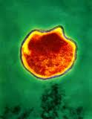
Question: Is the organism below (Chlamdyia bacterium) a prokaryote or eukaryote?

Slide 6
Question: You discover a unicellular organism that has its genetic material stored in a nucleus. Is it a prokaryote or eukaryote?

Slide 7
Question: What is the function of the cell membrane?

Slide 8
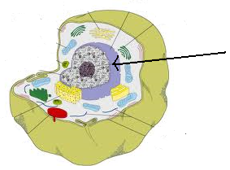
Question: What two things do the part labeled in the picture do?

Slide 9
Question: What three parts of the cell are involved in making proteins, moving them throughout the cell, and shipping them out of the cell?

Slide 10
Question: What three structures are found in the plant cell but not in the animal cell?

Slide 11
Question: What is the function of the central vacuole in the plant cell?

Slide 12
Question: What is one structure only found in the animal cell?

Slide 13
Edible Cell Project Objective
Objective: To create either an animal or plant cell using edible materials.
Your job is to use candy (!) to represent the following organelles in your “cell”. You must attempt to make the organelles look realistic as much as possible.
Required organelles: Nucleus, Ribosomes, Smooth and Rough Endoplasmic Reticulum, Golgi apparatus, Lysosomes, Mitochondria, Vacuole, and Cell Membrane (for both)
Plant cells have additional 3 organelles!

Slide 14
Edible Cell Project Expectations
Each group will draw an animal or plant cell card.
Each group member must fill out both sides of their project handout.
Health/Cleanliness
Behavior expectations
Expectations during and afterwards the project

Slide 15
Edible Cell Project
In addiction to your project handout, you will be graded by this rubric:
Rubric:
Complete: Your lab handout must have sections complete.
Creativity: Your cell must have a creative use of he different materials.
Participation: You must participate with your group in order to receive full credit. (I will be watching and making notes as you work.)
Make sure that you label everything on your cell. Your cell needs to follow the model on the handout.
EACH GROUP MEMBER MUST COMPLETE THE REVIEW QUESTIONS.

Slide 16
Rubric
Category | Complete
Completeness
Creativity
Participation

Slide 17
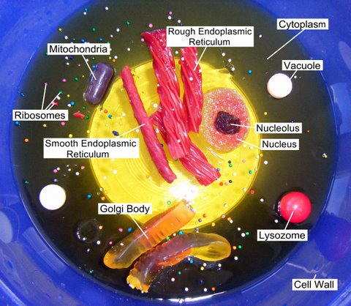
Example

