Slide 1
Catalyst #3: February 11th, 2015 (5 minutes)
During what stage of the cell cycle does a cell divide its genetic material between two new cells?
What is chromatin?
What are chromosomes?
A diploid cell has how many copies of each chromosome?

Slide 2
Agenda
Catalyst (5 minutes)
Mitosis and Cytokinesis (15 minutes)
Mitosis Graphic Organizer (20 minutes)
Exit Ticket(3 minutes)
Homework:
Honors Projects 3/13: ONE MONTH AND TWO DAYS
DBA #15: 2/17
Study for Cell Cycle Quiz

Slide 3
Announcements
3rd and 7th period 100%s
Testing schedule
2nd and 6th
Grade slips

Slide 4
Unit 6: Guiding Questions
Why do cells have to reproduce?
How do cells reproduce and replace dying cells and allow an organism to grow?
What is cancer and what causes cancer?
Why do children have features of both of their parents?
Why do siblings (except identical twins) have different features?

Slide 5
Today’s SPI & Objectives
SPI 3210.1.6 Determine the relationship between cell growth and cell reproduction.
SWBAT explain the purpose of mitosis
SWBAT summarize the events of each phase of mitosis
SWBAT identify the phases of mitosis based on a figure

Slide 6
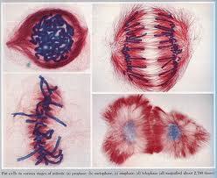
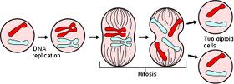
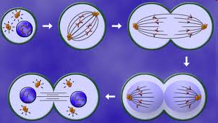
Mitosis and Cytokinesis

Slide 7
Review
The cell cycle is how all non-reproductive cells grow, divide and reproduce
Skin cells, muscle cells, blood cells, etc.
There are three stages in the cell cycle
Interphase
Mitosis
Cytokinesis
At the end of the cell cycle, two identical daughter cells have been formed

Slide 8
Mitosis: Purpose
Key Point 1: The purpose of mitosis is to divide the cell’s nucleus and genetic material (DNA) among the two new daughter cells
Each cell must have a copy of the same DNA

Slide 9
Mitosis
There are four sub- phases of mitosis
Prophase → Metaphase → Anaphase → Telophase

Slide 10
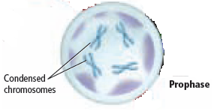
Prophase
Key Point 2: During prophase:
Chromatin condenses into chromosomes
Each chromosome looks like an X
The nuclear membrane disintegrates (breaks down and disappears)
Nuclear membrane= outer layer of nucleus
Spindle fibers form

Slide 11
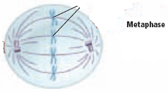
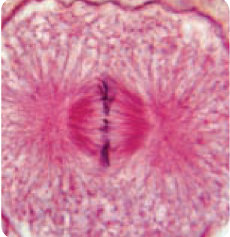
Metaphase
Key Point 3: During metaphase:
Spindle fibers connect the centrioles to the centromeres of each chromosome
Chromosomes line up along the middle of the cell
Meta= middle

Slide 12
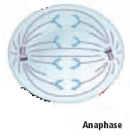
Anaphase
Key Point 4: During anaphase:
Spindle fibers shorten, pulling the sister chromatids apart
Sister chromatids move towards opposite ends of the cell
Ana=opposite

Slide 13
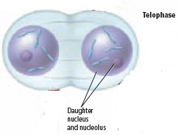
Telophase
Key Point 5: During telophase:
Chromosomes relax back into chromatin
The nuclear membrane reforms around the chromatin at each end of the cell
This ends mitosis and the division of genetic material

Slide 14
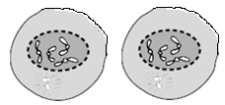
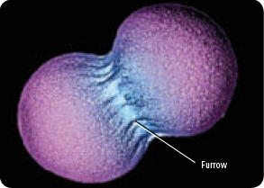
Cytokinesis
Key Point 6: During cytokinesis:
Proteins pinch the middle of the cell at each end, forming a furrow
The furrow divides the cytoplasm, splitting the cell into two new identical cells
Plant cells form a cell plate instead of a furrow

Slide 15
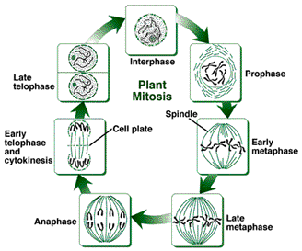
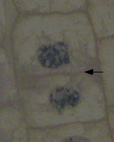
Additional notes: plant cell Cytokinesis
Cytokinesis occurs through a “cell plate”
Cell plate made of cellulose (a type of starch)
Becomes part of the plant wall

Slide 16
But ms. Mitchell, how will I remember all this?

Slide 17
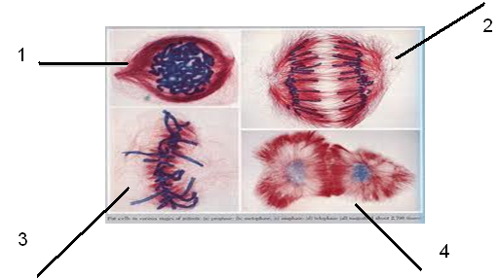
Check for understanding
What phase is each picture, and what is happening in each?

Slide 18
Mitosis Video
http://www.teachersdomain.org/asset/tdc02_vid_dnadivide/
http://www.cellsalive.com/mitosis.htm

Slide 19
Mitosis Graphic Organizer
Complete both sections of your graphic organizer.
Write a brief description. Try to use your own definitions as much as possible. WHAT IS HAPPENING TO THE CHROMOSOMES IS THE MOST IMPORTANT PART!
Draw a picture of what is happening in each sub-phase.
I will grade your graphic organizer when it is complete.

Slide 20
Instructions
Complete your Mitosis graphic organizer using your notes.
Have me check your sheet when you are done
10 bonus points for color added
When you finish, begin on your exit ticket

Slide 21
Exit Ticket
Answer the following questions:
Name the 4 phases of mitosis in the proper order.
What happens during prophase?
In what phase of mitosis do chromosomes line up along the middle of the cell?
What phase is shown below?

Slide 22
Catalyst # 3 1/2: February 11th, 2015
1. During which sub phase of mitosis are sister chromatids pulled towards opposite ends of the cell?
2. Which of the following represent the phases of mitosis in their proper sequence?
Prophase, metaphase, anaphase, telophase
Interphase, prophase, metaphase, anaphase, telophase
Prophase, metaphase, anaphase, telophase, cytokinesis
Metaphase, anaphase, telophase, prophase

Slide 23
Agenda
Catalyst: 5 minutes
Tracking: 10 minutes
SWAT!: 10 minutes
Mitosis Sub-Phases: Animal and Plant cells : 30 minutes
Exit Ticket: 5 minutes
Reminders:
DBA #15: 2/17
Honors Projects 3/13
Study for cell cycle quiz

Slide 24
Announcements

Slide 25
Unit 6: Guiding Questions
Why do cells have to reproduce?
How do cells reproduce and replace dying cells and allow an organism to grow?
What is cancer and what causes cancer?
Why do children have features of both of their parents?
Why do siblings (except identical twins) have different features?

Slide 26
SWAT!

Slide 27
Mitosis: animal and plant cells
You need the following colors:
Pink, Light green, red, light blue, yellow

