Slide 1
Notes:
Materials: Dixie cups, same brand of coke; bias guided notes; notebook basics
Daily differentiation/student learning choices: pull outs during independent working time; scaffolded release
Inquiry build-in: bias
ACT focus: bias practice
Reinforcement: Bias practice questions
EOC/Unit assessment connection: Bias practice questions
CFUs/Higher order questioning: During whole class bias scenario practice
Lesson topic: Experimental Bias
Classwork: INS set-up, Kroger coke demo, Intro to bias, Bias identification practice,
Homework: Interactive Notebook set-up

Slide 2
Catalyst: August 14th, 2014
Check the number on the back of your ActivExpression. It should correspond with your desk number. You are responsible for this clicker!
We will be going over the Activ Expression procedures for the class.
DO NOT turn on the clicker until I ask you to!

Slide 3
Agenda
Catalyst: 8 minutes
Kroger vs. Coke Demo: 10 minutes
Bias Notes and Guided Practice: 18 minutes
Exit Ticket: Remainder

Slide 4
Announcements
Materials due MONDAY
Procedures Review
Unit 0 Study Guide
Class Job Applications due tomorrow

Slide 5
Objectives
SWBAT define bias.
SWBAT identify bias in an experiment.
SWBAT communicate the effect (intended or unintended) of bias on experimental results.

Slide 6
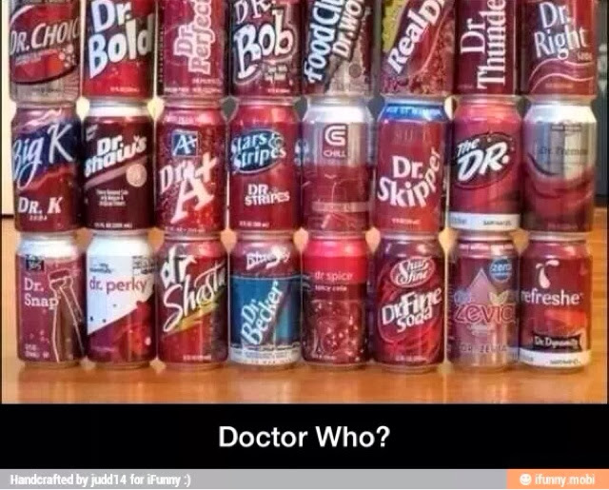
Hook: Generic vs. Name brand
Each student will get 2 items: one is name brand and one is generic
Determine which is the name brand product.
Evidence?
Experience?

Slide 7
Bias Discussion
What led us to our decision?
What experiences led us to this decision?
Bias definition? Examples?
Notes:
Because you said that it was Kroger brand.
No, because those results would not be true. The people participating would have been influenced in some way.

Slide 8
Key Point 1
Bias is a prejudiced presentation of material.
Two main types of bias:
1. Sampling bias
2. Measurement bias

Slide 9
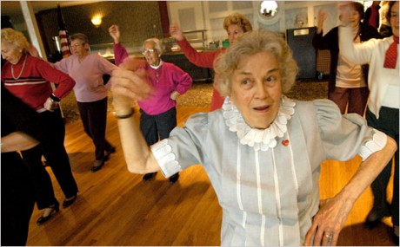
Key Point 2: Sampling Bias
A sample is a group of units selected to be “measured” from a larger group (the population). These are used for the experimental and control groups.
Sampling bias is introduced when the sample used is not representative of the population, is too small to represent the population, or not randomized.
Example: Old people and dancing

Slide 10
Factors that contribute to sampling bias
SAMPLE SIZE: Is the sample big enough to get a good average value? (Remember our McDonald’s v. BK)
SELECTION OF SAMPLE: Does the composition of the sample reflect the composition of the population?
Factors such as location, age, gender, ethnicity, nationality and living environment can affect the data gathered. (Memphis vs. Germantown)
How to minimize sample selection bias:
Use a RANDOM SAMPLE = every individual has an equal likelihood of being chosen.
Use a LARGE SAMPLE = more reflective of the general population
Notes:
Discuss these examples to help explain the way these different factors can cause sampling bias.
Sample Size:
Ex. To determine the average height of students in this classroom, how many students should I measure to get the best estimate? If I only measure 3 will my mean be accurate?
Sample Selection:
Factors such as location, age, gender, ethnicity, nationality and living environment can affect the data gathered for a sample. A good experiment controls for these factors by using a random sample or by limiting the question asked to the specific group represented by the sample.
Random sample = Samples drawn in such a way that every individual has an equal likelihood of being selected.
Example of random sample: Rolling dice, flipping a coin
Example of sample selection bias:
I want to find the average height of students in the classroom. I notice a list of students that are to be excused early because they are on the basketball team and have a game. I decide to use this list to pick the students that will be in my sample. How might this method of selecting my sample bias my estimate of average height?
♣ What are factors that contribute to sampling bias?
♣ What are some ways to minimize sampling bias?

Slide 11
Measurement Bias
Measurement Bias is when the method of data collection is conducted in a way that does not reflect reality.
Examples:
Measurements taken inaccurately
Additions to the environment that will influence results
Experiment designed to isolate the effect of multiple factors (Sleep and Testing)
Example: Measuring height
Notes:
Discuss these examples to help explain the way measurement technique can cause measurement bias.
Use measurement tool correctly
Ex. When measuring height, I must be careful to start the measuring tape at exactly at 0, not at 1 cm.
No additions to the environment that will influence results
Ex. I take height measurements of everyone in the classroom and let them keep their shoes on. All shoes add height, some more than others, and this will change the measure I get for average height.
Experiment designed to separate out the affect of multiple factors
Ex. I propose the hypothesis that students that sleep more than 7 hours the night before a test will perform better on the test. I ask students to report how much sleep they received the night before on their tests and compare this with their test scores. I do not ask or control for other factors such as how much each student studied or whether they ate breakfast. How can I know that any trend I observe is reflective of how much sleep they received and not other factors?
♣ What are 3 factors that contribute to measurement bias?

Slide 12
In order to avoid bias, the scientific community engages in certain quality control measures.
Results are verified by independent duplication (repetition) and published in peer-reviewed journal.
Independent duplication = Two or more scientists from different institutions investigate the same question separately and get similar results.
Peer-reviewed journal = A journal that publishes articles only after they have been checked for quality by several expert, objective scientists from different institutions.
Notes:
The scientific community has long recognized that bias can be found in scientific studies either by unintentional mistakes on the part of scientist or by intentional attempts to make data show a particular, desired result. There are several “rules” or procedures used by the scientific community to eliminate (or at least reduce) bias in science. These procedures include independent duplication and confirmation by others and the requirement for publication in a peer-reviewed journal.
♣ What measures does the scientific community take to minimize bias in science?

Slide 13
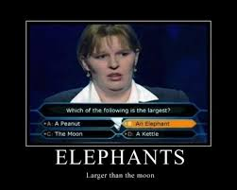
Identifying good science: Look for signs of bias!
1. Language
2. Appropriate data reported to back conclusions
3. Data source
Notes:
♣ What are some clues that scientific information you are reading is biased?

Slide 14
Language
“Scientifically-proven”
* Science does not seek to prove but to disprove
* Be suspicious of this claim!
Emotional appeals
* Conclusions should be data-based
* Emotional appeals usually are not data-based
Example: . “People will senselessly die unless we use Vacinax now!”
Strong language
* Scientific conclusions should only report what the data supports.
* Words should be chosen very carefully
– “cleanest”, “cheapest”, “ most efficient”, “in the world”
to avoid exaggeration or claims not supported by data.
THE DATA SHOULD CONVINCE YOU,
NOT THE WORDS USED!
Notes:
Discuss examples for evidence of bias.
1. Emotional appeal – gives emotional reasons for believing or not believing the scientific
conclusions. “People will senselessly die unless we use Vacinax now!”
2.“scientifically-proven” – science sets out to disprove, not prove things. Thus anytime
you encounter the phrase “scientifically-proven”, be suspicious.
3. Identify strong language – “cleanest”, “cheapest”, “ most efficient”, “in the world”

Slide 15
Data Sources
University Research
Corporate Research
Government Research
Research by Special Interest Groups
These organizations are often sources of reliable science. However, it is important to understand the organization’s motivation to be able to identify potential bias. In some situations, the need to promote special interests or make profits may lead to bias.
Notes:
You may want to highlight that there are plenty of examples of both good and bad research done by all of these groups. A careful understanding of the interests and funding sources of research will give you an idea of what the bias might be if the research is biased. However, even if a scientist has an interest in getting certain results it does not mean that their research will be biased. If they are a good scientist, they will be true to the scientific process and they will design good experiments and report data honestly, regardless of their interests.

Slide 16
Bias Practice Questions Expectations
On your own sheet of paper
3 Bias Practice Problems: 1st together, 2nd Think-Pair-Share, 3rd independently

Slide 17
Bias Practice 1 : Teenagers + Smoking
Experiment 1: Dr. Jackson is making observations at Davisville High School to investigate the rate of smoking among American teenagers. Dr. Jackson decides she will observe students having their lunch in the parking lot where smoking is permitted. Dr. Jackson observes 25 out of 30 students smoking in the parking lot. Based on her observations she records that 83.3% of American teenagers smoke.
Source of Bias____________________________________________________________
What Type of Bias? ________________________________________________________
Possible Effects of Sampling Bias on Results:
Notes:
Source: Only observes students in the smoking parking lot
Type: Sampling
Effects: Might seem like more students smoke than really do at the high school

Slide 18
Bias Practice 2
Experiment 2: Dr. Cloud is conducting interviews of Davisville and Springville High School students to determine the rate of smoking among American teenagers. Dr. Cloud gets a list of all the students from each high school and randomly selects 50 students from each school. An appointment for the interview is scheduled with each student and their parents. Each student is interviewed with their parents in the room. The students are asked questions such as, “Do you smoke regularly?”, “Have you ever smoked?”, and “What percentage of your friends smoke?” After finishing the interviews Dr. Cloud concludes that only 1% of American teenagers smoke regularly and 18% of teenagers have tried smoking.
Source of Bias____________________________________________________________
What Type of Bias ________________________________________________________
Possible Effects of Sampling Bias on Results:
Notes:
Source: Asks them in front of the parents
Type: Measurement (doesn’t reflect reality)
Effect: Smaller number

Slide 19
Bias Practice 3
Experiment 3: Dr. Garcia is using both observations and interviews to investigate the rate of smoking among American teenagers. She first selected three study sites: one urban, one rural, and one suburban. Dr. Garcia went to two popular teenage hangouts in each study site and made observations of the teenage students standing around the buildings. She observed a total of 117 students and of those 33 were smoking (28%). Dr. Garcia then went to one high school in each study site and interviewed 25 students from each school. The principal of each school selected the 25 students that would be interviewed for Dr. Garcia’s study. Of the 75 total students only 3 said that they smoked regularly (4%). Taking the average percentage from her observations and interviews, Dr. Garcia concluded approximately 16% of American teenagers smoke.
Source of Bias____________________________________________________________
What Type of Bias ________________________________________________________
Possible Affects of Sampling Bias on Results:

Slide 20
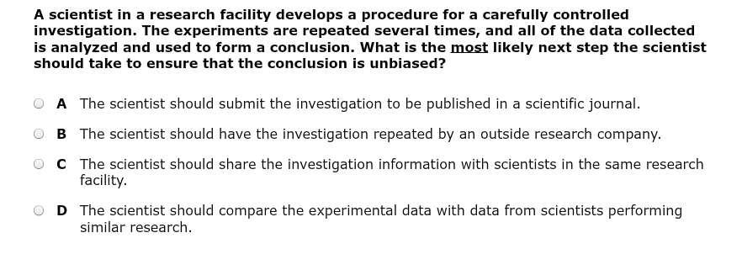
Exit Ticket: Question 1

Slide 21
Exit Ticket: Question 2

Slide 22
Closing/Reminders
Materials due on Monday FOR A GRADE
Class Jobs applications due on Friday
Unit 0 Study Guide
Procedures Review: Expectations/Consequences, Hall pass, Catalysts, Passing Out/In papers, Textbooks, Unprepared for class, Tardies, Note taking, Homework Bingo

