Slide 1
Homeroom Agenda
Introduction/Roll
Schedules (Schedule instructions)
GTYK activity if time
Notes:
Red cards/Green Cards

Slide 2
Catalyst: Do this now!
Biology
Ms. Mitchell
Room 113
August 5th, 2013
1. Label your manila folder ON THE TAB with your NAME and CLASS PERIOD.
2. Fill out the student survey in your folder silently, at your desk, and by yourself.
3. If you finish early, look over the syllabus and other materials in your folder.
Notes:
Seating charts attached to folders
Materials: Seating chart, prepared folders (parent letter, syllabus, student survey,, post it notes
Daily differentiation: Slap the Door Exit Ticket
Inquiry build-in: Introduction to Ms. Mitchell’s science class
ACT focus: None
Reinforcement: Syllabus
EOC/Unit assessment connection: None
Lesson topic: First Day of School
Catalyst: Student survey
Classwork: GTKY activity, introduction to Ms. Mitchell, syllabus overview
Homework: Buy materials and have parent letter signed.

Slide 3
Organization
Folder: To keep class materials in until you have your materials
Syllabus: 2 pages, stapled
Parent letter: Overton header
Class Surveys: Phone numbers, questions

Slide 4
Agenda
Catalyst: 5 minutes
First period: Handbooks/Sign-off sheet
Introduction to Ms. Mitchell: 5 minutes
Syllabus: 10- 20 minutes
Closing: Slap-the-Door/GTKY: If time

Slide 5
Announcements
Parent Letter due Monday, August 18th, 2014
Materials due Monday, August 18th, 2014

Slide 6
Objectives (What are they?)
SWBAT describe contents of the syllabus.
SWBAT list the materials and expectations needed for class.
SWBAT the expectations and consequences system.
SWBAT participate in GTKY activities.

Slide 7
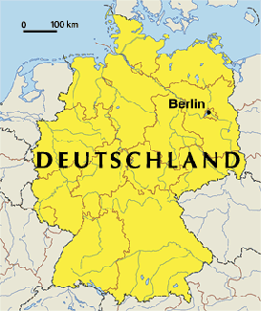
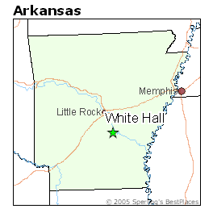
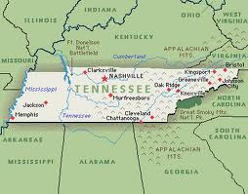
Intro to Ms. M!

Slide 8
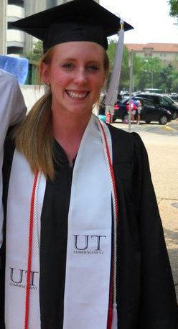
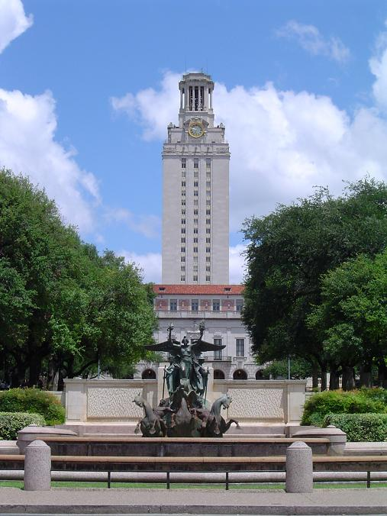
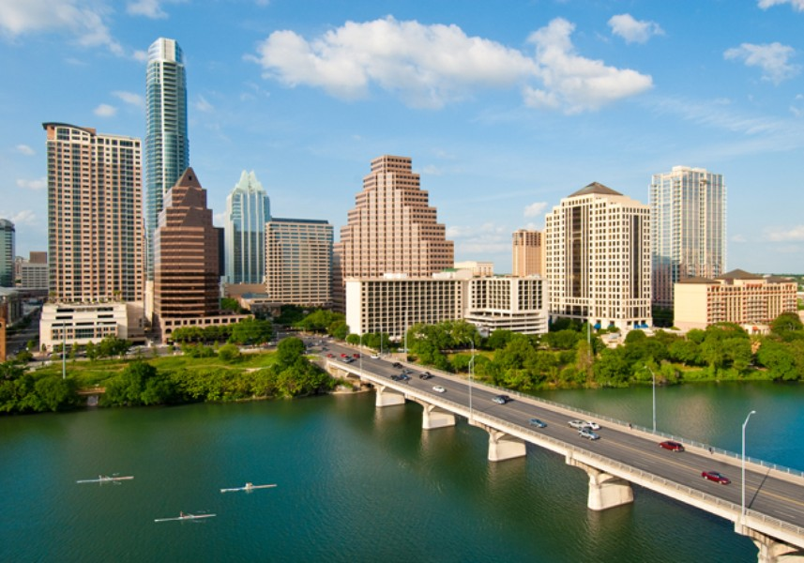
School + Ms. Mitchell
University of Texas at Austin

Slide 9
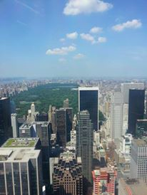
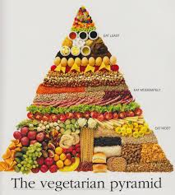
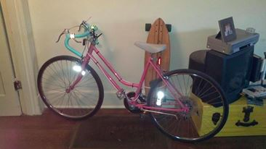
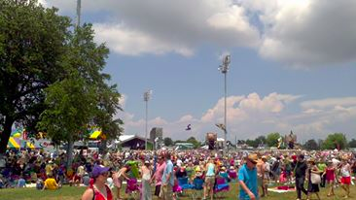
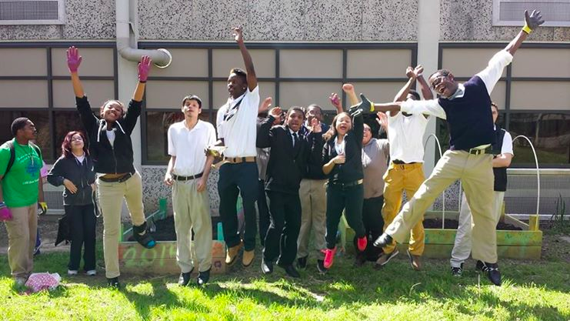
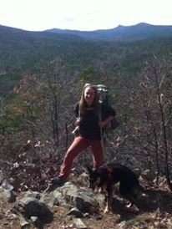
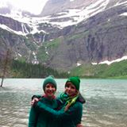
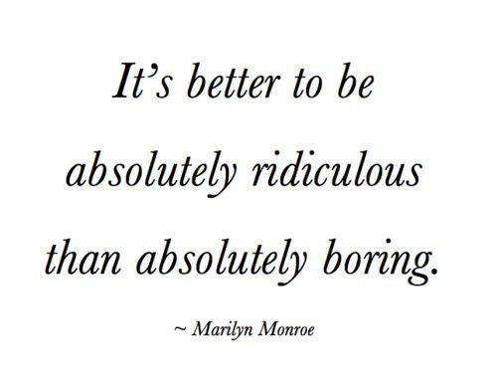
Stuff I Like

Slide 10
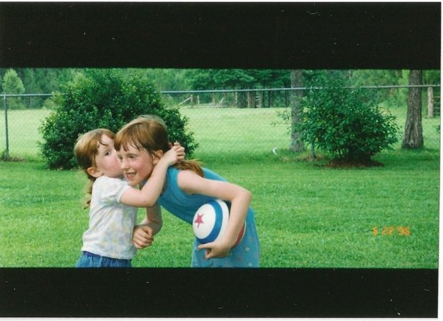
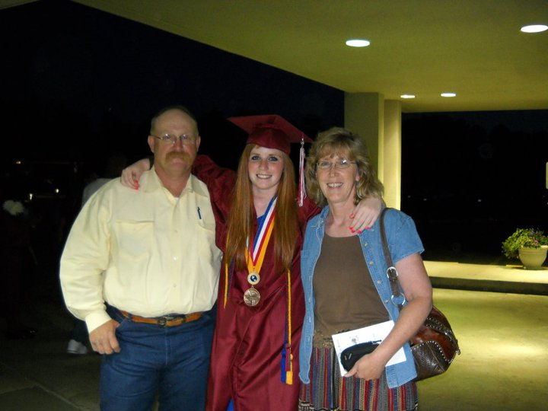
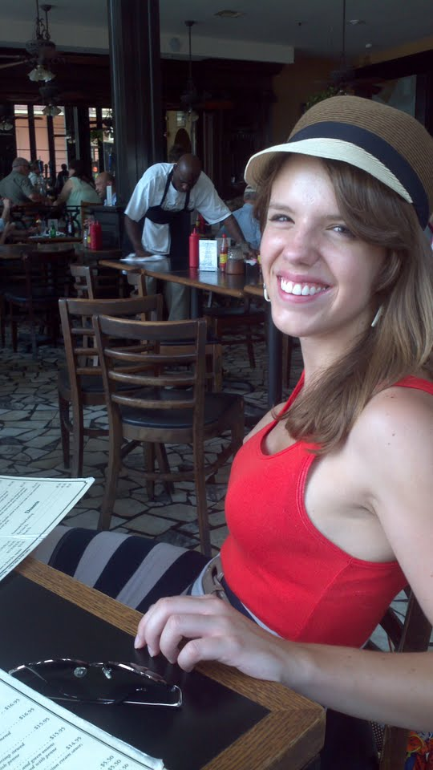
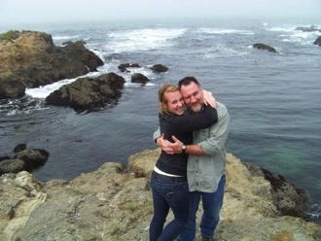
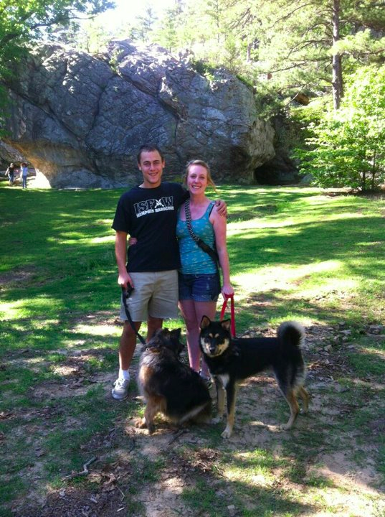
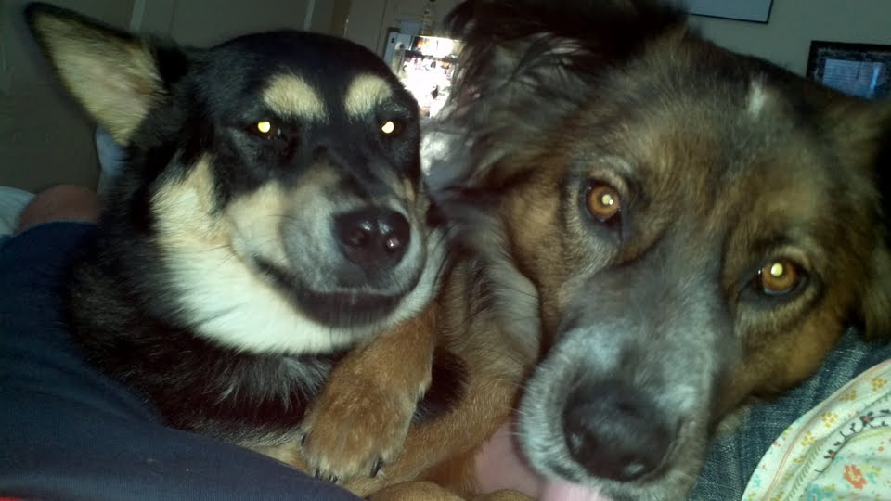
People (and animals) that I love

Slide 11
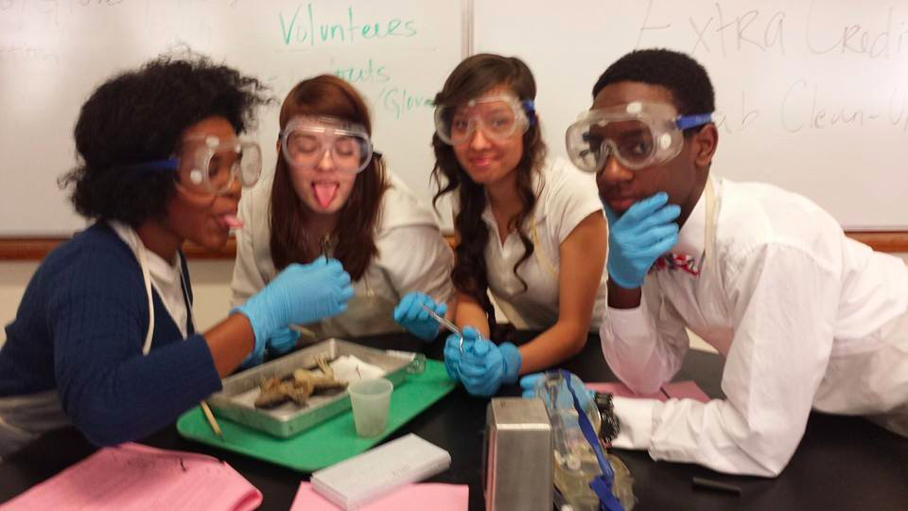
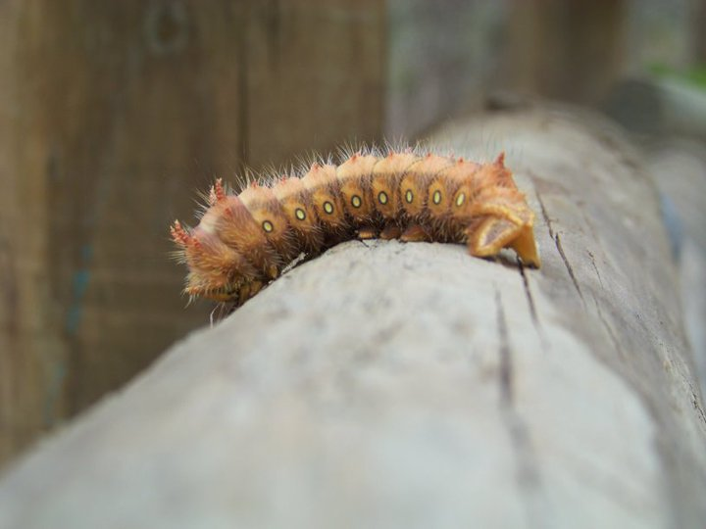
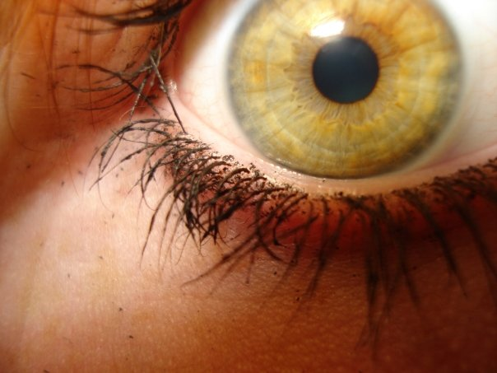
Biology!!

Slide 12
Syllabus: 10-20 minutes
Contact informationGoals
Materials
Daily Work Organizers
Standards Based Grading
Flipped Classroom
Rewards system

Slide 13
Syllabus: Contact Information
Phone: 903.293.6419
Email: mitchellm5@scsk12.org (Typo)
Office hours (Tutoring): Tuesday and Thursday, 2:15 -3:15 p.m.

Slide 14
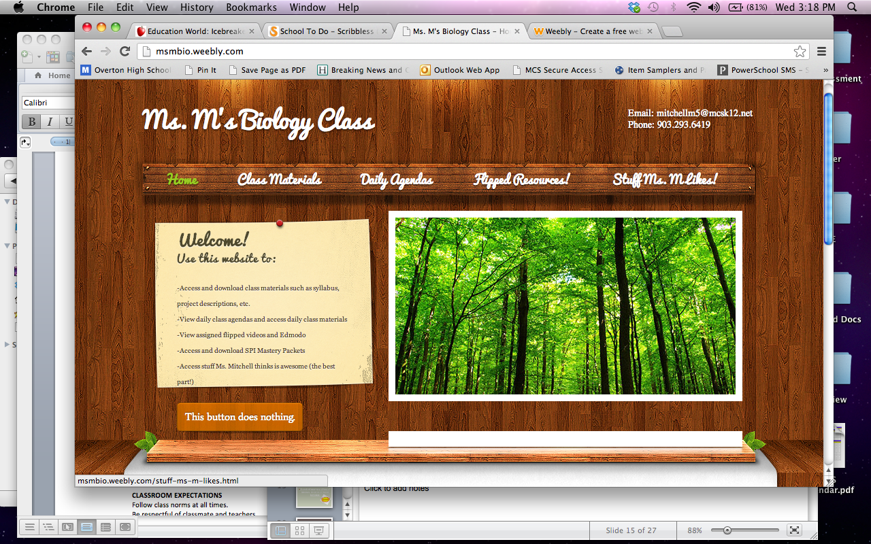
Bio: Website
Class website:
www.msmbio.weebly.com
Access class materials
Daily lessons
Flipped videos
EVERYTHING

Slide 15
Regular bio Course goals
To score at least Proficient of the Biology End of Course exam
At least 5 points of growth on the science ACT
Proficient/Advanced on at least 85% of the class standards

Slide 16
Honors bio Course goals—more information to come!
To score Advanced of the Biology End of Course exam
At least 5 points of growth on the science ACT
Proficient/Advanced on at least 85% of the class standards

Slide 17
Materials: You Must Have!
A three ring binder (1 inch preferably)
2 sets of Tab Dividers
1 pack of college-ruled paper (for this class only)
1 roll of paper towels
You have until Monday, August 18th to purchase these supplies. This will count as a grade.
Optional:
For 50 DOJO POINTS: one box of tissue, one bottle of hand sanitizer, one package of glue sticks or glue, one package of scissors, or one package of colored paper (Due by August 18th)
Notes:
Binder sale

Slide 18
Organization: Binders
Binder is only for this class
Organized by unit
Assignments will be numbered
Binder checks
Pop binder quizzes

Slide 19
Daily work organizers: because I go crazy if things are not organized
Objectives
Catalysts
Notes
Tracking
A note about absences!

Slide 20
Standards based grading
QUESTIONS?

Slide 21
Flipped classroom
*If time
Edmodo
Khan Academy

Slide 22
Rewards systems-more to come!
Dojo Points
Homework Bingo
Class Jobs
100%

Slide 23
Classroom Expectations
Follow class norms at all times.
Be respectful of classmates and teachers.
Follow directions the first time they are given.
Come to class prepared.
Clean up after yourself.
Follow Overton rules. (What this means)
WORK HARD.
NO EXCUSES.

Slide 24
Consequences
1. Verbal Warning
2. In Class Intervention (Examples: distance, conversation, loss of privileges ,phone call )
3. Step Plan (Parent phone call, step letter)
4. Referral ( I reserve the right to move past steps on the consequence ladder in response to the level of behavior.)

Slide 25
Ms. M Expectations
Fairness and consistency, excellent, engaging classes that take place in a safe learning atmosphere
Letters of recommendation for college; job reference
Respect and caring. I will always treat you with respect and will always be available to help and listen to you.
An open line of communication. You can call/text/email me!

Slide 26
GTKY: Enough about me!
1. Take a handful of M&Ms. DO NOT EAT THEM YET!!
2. Close your eyes and randomly pull ONE.
3. We will go around the room and share something about ourselves based on the color of the M&M you picked!
RED: Something interesting you did this summer.
ORANGE: Something you do well (hobby/talent)
BLUE: A weird fact about you
BROWN: Someone you can’t live without
GREEN: Advice you would give a middle schooler

Slide 27
Quick summary
Materials
Expectations
Consequences
Questions?

Slide 28
Closing
Reminders:
Due August 18th.
Bottom portion of syllabus
Materials
Additional materials (optional)

Slide 29
Exit Ticket: Slap the Door
On your post-it note:
Write your initials.
Write 3 things you are excited about for this year. (It can be class related or not.)
Write 2 interesting things about yourself. (As always—class appropriate!)
Write 1 question that you brainstormed with your partner.
On your way out, “slap” your post-it on the door!

