Slide 1
Notes:
Materials: White paper, markers, other art supplies
Daily differentiation: Individual life map creation, choice of exit ticket reflection ticket questions, using pictures in my slide show
Inquiry build-in: Goal exploration
ACT focus: ACT statistics
Reinforcement: Review in tomorrow’s lesson
EOC/Unit assessment connection: Goals discussion
Lesson topic: Life/Classroom Goals
Classwork: Life maps, goal discussion
Homework: Purchase materials; parent letter
Prep: My life map

Slide 2
Catalyst #1: 5 minutes
On a sheet of notebook paper: Write “Catalyst #1,” the date, and your response. YOU MUST WRITE IN COMPLETE SENTENCES. YOU DO NOT HAVE TO WRITE THE QUESTION.
1. Name one classroom expectation.
2. Name one thing you need for this class.
3. When is the parent section of your syllabus due?
4. Name one future goal you have for yourself. (Can be college, career, owning a house, etc.)
Why “Catalyst”??

Slide 3
Catalyst (Bellwork) Procedure
Every day.
100% participation
A chance for review: NOT PUNISHMENT
Random checks!
Procedure
CFU

Slide 4
Agenda
Catalyst: 5 minutes
Catalyst Procedure: 5 minutes
Class Set-Up: 2 minutes
Quick Review/Slap-It Questions: 5 minutes
Hall Pass: 5 minutes
Class Goals: 15 minutes
Identity Maps: Remainder

Slide 5
Announcements
Parent Form: Due Monday, August 18th, 2014
Materials: Due August 18th, 2014 (Quick supply review)
BOY materials: www.msmbio.weebly.com
New student packets

Slide 6
Objectives
SWBAT describe and implement the expectations and consequences system.
SWBAT practice the hallpass procedure.
SWBAT describe the Catalyst procedure.
SWBAT articulate class goals and how it relates to the achievement gap.
SWBAT explore their own personal identities through an identity chart.

Slide 7
Quick review
Expectations/Consequences Review
Syllabus
Materials/Extra credit materials

Slide 8
Classroom Expectations
Follow class norms at all times.
Be respectful of classmates and teachers.
Follow directions the first time they are given.
Come to class prepared.
Clean up after yourself.
Follow Overton rules.
Work Hard.
No excuses.
EXPECTATIONS

Slide 9
Consequences
1. Verbal Warning
2. In Class Intervention
3. Step Plan/Improvement Plan
4. Outside Intervention (Office referral)
CONSEQUENCES

Slide 10
Hall pass procedure
15/15 policy
Where it is
When to request hallpass
Signals: Bathroom, Pencil, Hygiene
You MUST sign the whiteboard with your name/time out/destination
Acceptable reasons to have the hall pass?
Unacceptable reasons to ask for hall pass?
What happens if you are gone for too long/take too many hall pass breaks?

Slide 11
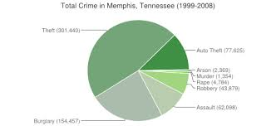
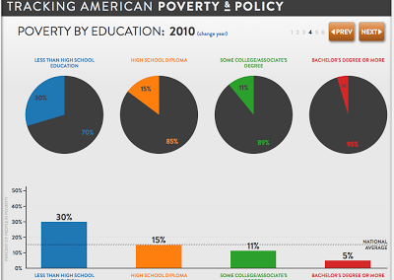
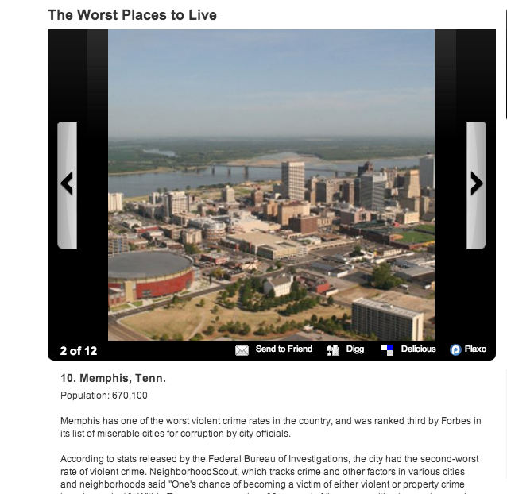
What are statistics?
What do they say about us?

Slide 12
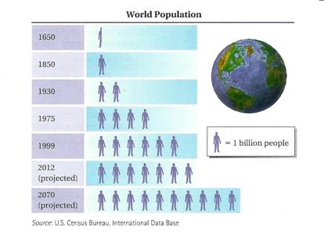
Statistics: Trends + Patterns

Slide 13
Statistics: Big picture view

Slide 14
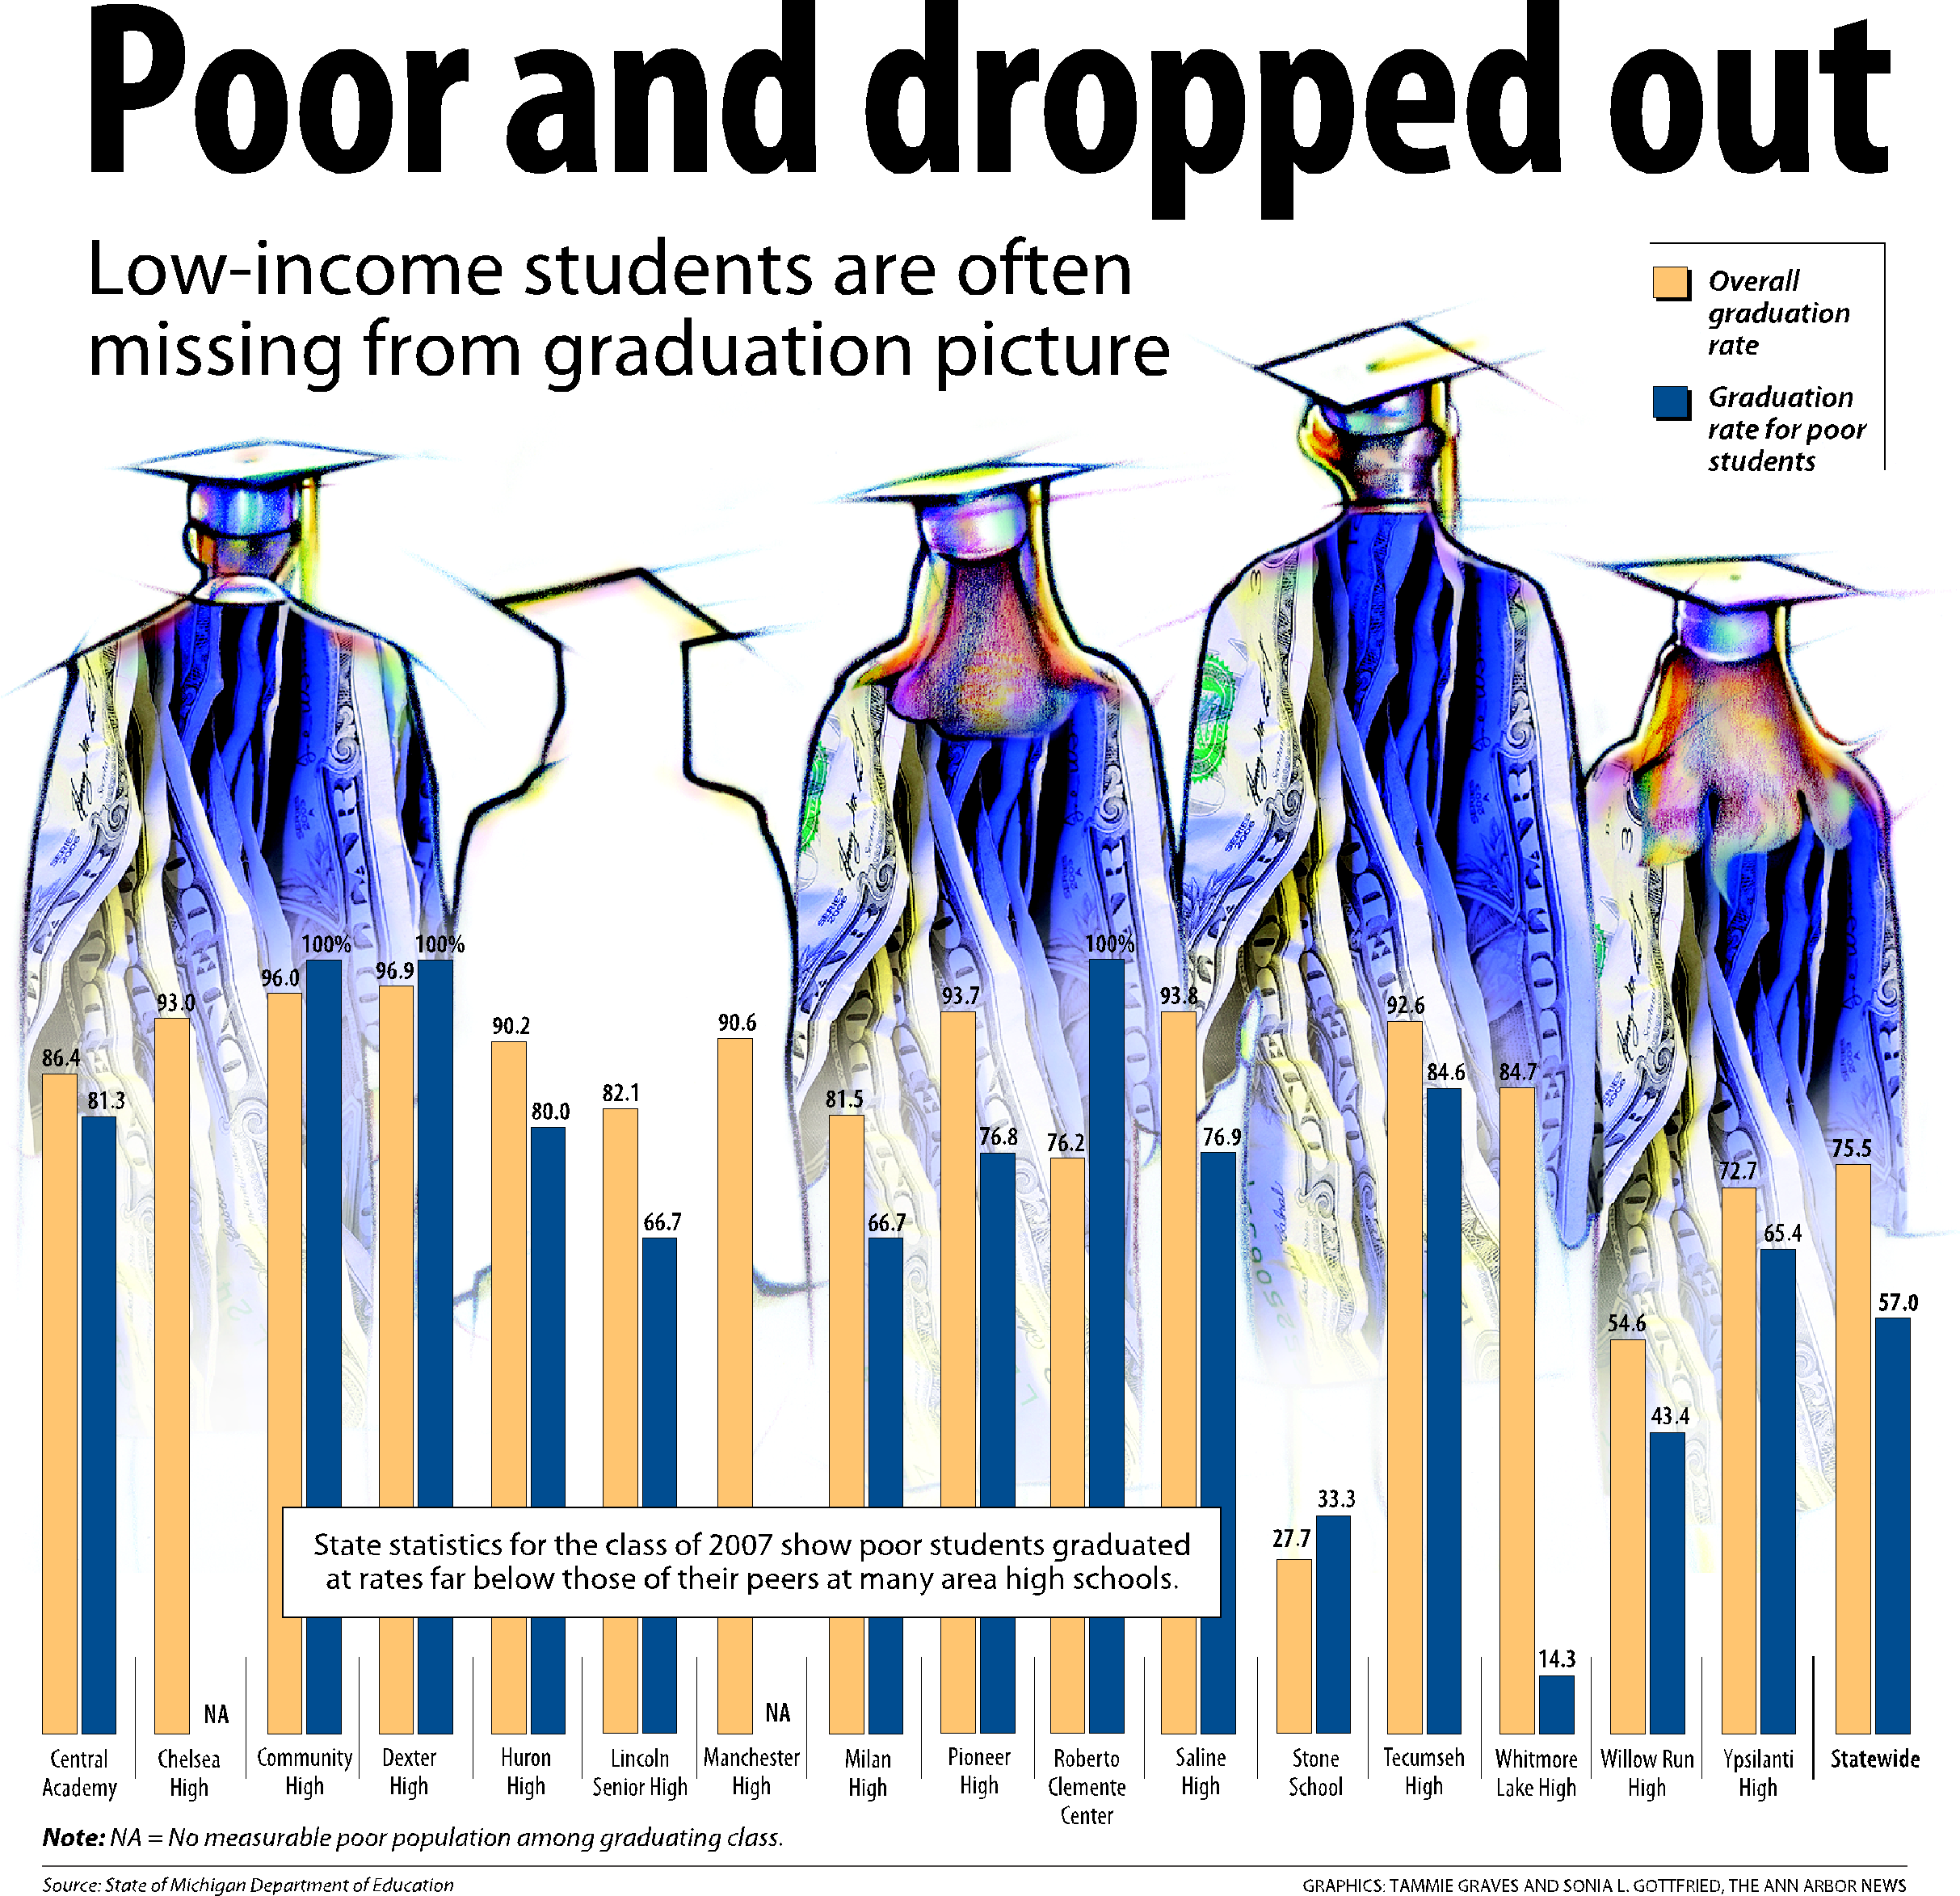
Statistics: stories

Slide 15
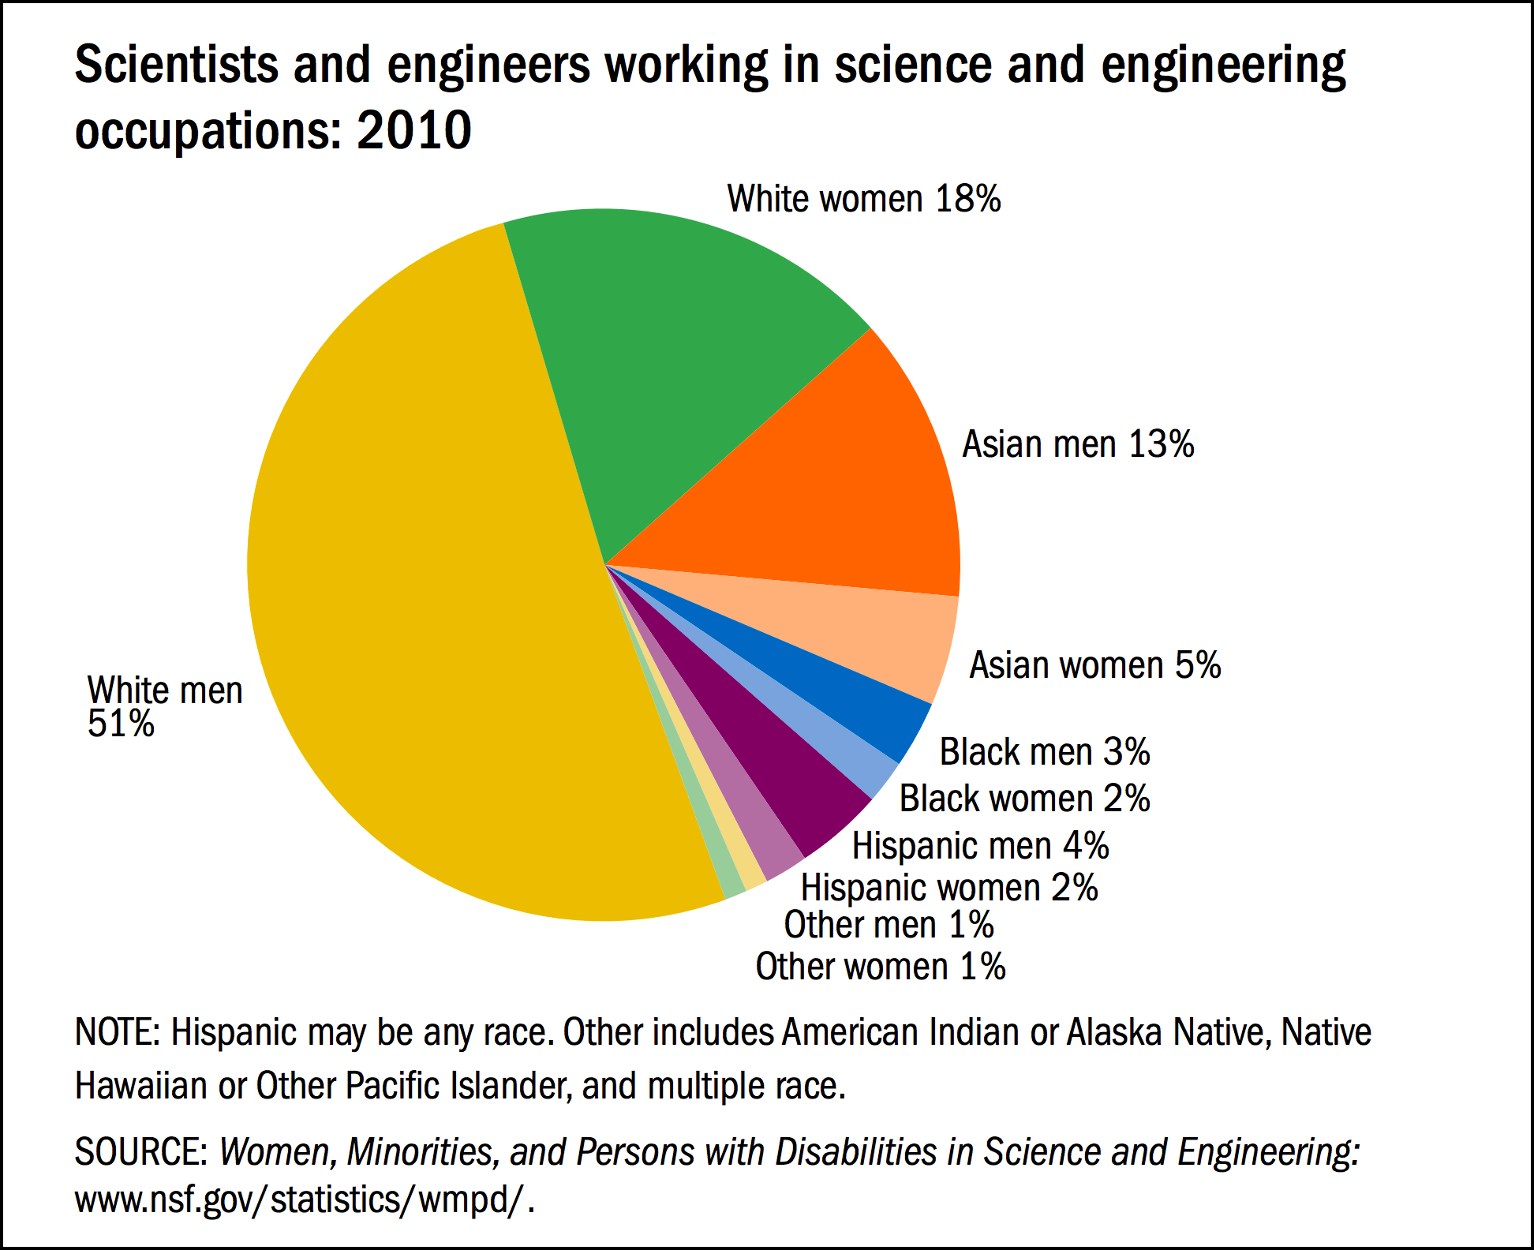
Statistics: Stories

Slide 16
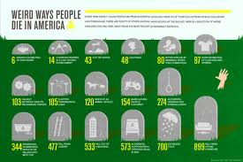
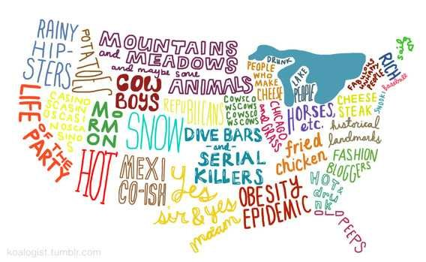
But….Statistics are not rules or laws

Slide 17
What story do statistics about us tell?

Slide 18
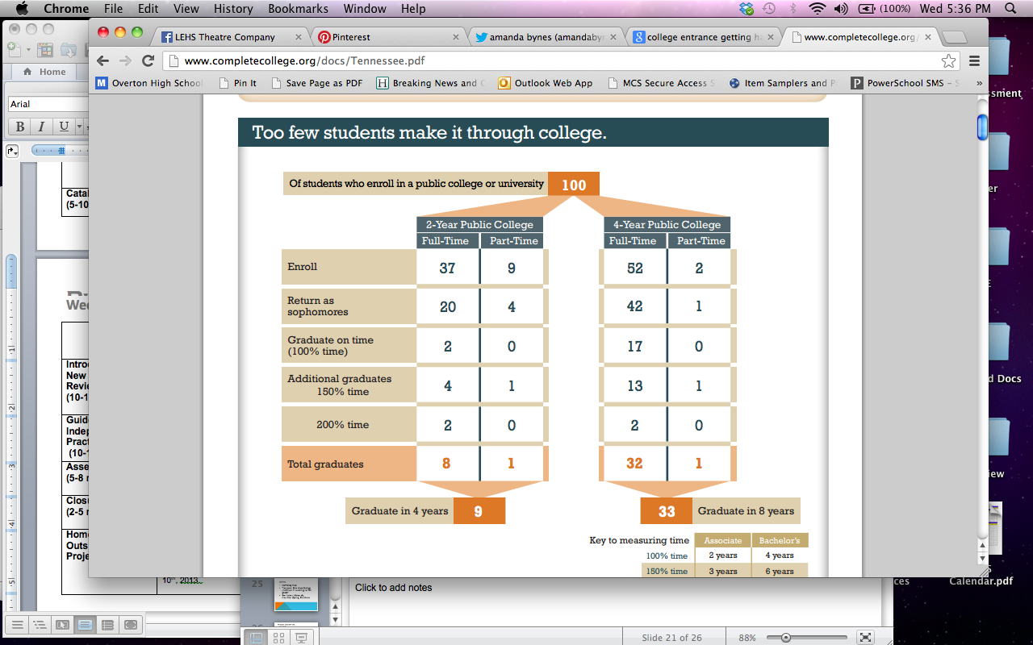
Some Statistics: At home
http://www.hlntv.com/article/2012/01/17/principals-racial-stats-test-cause-uproar
ACT Scores
Composite
25% 75%
Brown 29 34
Columbia 32 35
Cornell 30 33
Dartmouth 30 34
Harvard 32 35
Princeton 31 35
U Penn 30 34
Yale 31 35
The average ACT score at Overton is 17.4. The median ACT score at University of Tennessee is 21.

Slide 19
What will happen if we do follow the pattern?

Slide 21
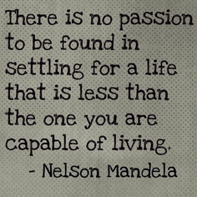
WE ARE THE AUTHOR OF OUR STORY: Class Goals
What is a goal?
Why are goals important?
Why would we have goals in Biology class? Why would they matter?
Share goals
Notes:
Have students raise hands if they have personal goals. Ask one or two to share.

Slide 22
My Hope for your future
My hope is that each of you have as many options as possible for your future when you graduate from high school
That is why I take teaching so seriously and why I will push you to work hard throughout the whole year.

Slide 23
Goals…
A goal requires:
Information
Planning
Action
Perseverance

Slide 24
Class Goals
To score proficient on the EOC
Proficient/Advanced on at least 85% SPIs
At least 5 points of growth on the ACT
Why?!

Slide 25
Honors Class Goals
To score advanced on the EOC
Proficient or Advanced on at least 85% of state standards
At least 5 points of growth on the ACT
Why?!

Slide 26
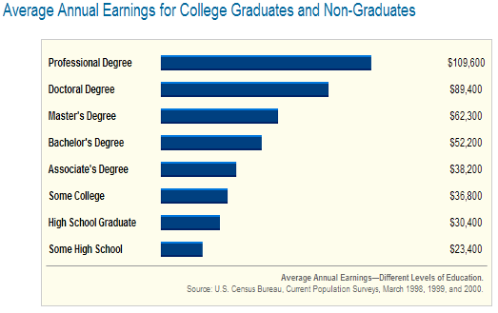
The Value of your Education
-If you go don’t graduate from high school, you can expect to earn about $23,000 per year.
-If you graduate high school, you can expect to earn about $30,000 per year.
-If you graduate from college, you can expect to make $52,000 per year.
-If you go on to earn a Master’s degree or higher, you can bring home more than $62,000 each year.

Slide 27
Employment
On average, only 2 out of every 100 people with professional degrees will not have jobs at a given time
However, 15 out of every 100 people without a high school diploma not have jobs at a given time
…and this number is rising!

Slide 28
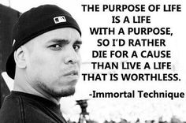
Service and Giving
A higher level of education and a better career also open up more opportunities to help others
Jobs in education, medicine, law enforcement, politics
Giving to charities and friends in need
Going on service/missions trips

Slide 29
Athletes/Musicians/Actors
Professional athletes, musicians, and actors make very high salaries, but the number of individuals that enter those careers is incredibly small.
Education is a great fall-back if those careers do not work out!
Example: Ms. Mitchell and Hollywood

Slide 30
How will we keep track of our goals?
What is a tracker?
Individual trackers
Wall tracker
Whole class mastery

Slide 31
Passing is NOT enough
Anything worth doing is worth doing well.
We need to raise the bar for all of Memphis.
Excellence should be our goal, not just getting by.

Slide 32
Identity maps
Your life map should include:
People
What family members and relatives have always been present in your life?
Who are your close friends?
Who are your role models?
Places
Where were you born?
In what cities/states have you lived?
What schools have you attended?
Events
What important events have happened in your life since you were born?
What have you done in the past year?
You
How would you describe yourself today?
What do you like to do?
What are your goals?
Identity maps are a great way to give others a glimpse of who you are:
-Important people and events
-Places
-Goals
There is no correct way to write a identity map
Triangle: Future
Square: Environment
Circle: Something that has taken practice
Star: Future

Slide 33
Rubric
CATEGORY | POINTS EARNED | POINTS TOTAL
Correct: Did you follow instructions? Did you include the required elements in your life map?
Complete: Is your life map complete? Did you manage your time well?
Creativity : Is your life map aesthetically pleasing? Does it reflect time and effort?

Slide 34
Exit Ticket
1. Name one ACADEMIC goal (school-related) you wish to accomplish. How will you get there?

Slide 35
Closing
Summing it up
Tomorrow: How do we figure out if we are reaching these goals?
Reminders: Materials/Extra credit materials, Guardian signing, Class Website

