Slide 1
Notes:
Daily differentiation: Kinesthetic/visual/written (learning styles)
Inquiry build-in: None
ACT focus: None
Reinforcement: Class norms creation
EOC/Unit assessment connection: None
Lesson topic: Class Norms and Tolerance
Classwork: Procedures introduction, class goal review, class norms creation, Take a Step exit ticket
Homework: Materials and Parent letter

Slide 2
Catalyst #3: August 7th, 2014
On your Catalyst paper, write the following statements and AGREE/DISAGREE.
I was born in Memphis.
Love the Grizzlies.
I personally know the person I respect the most.
I have a secret that no one knows.
I deserve respect.

Slide 3
Agenda
Catalyst: 5 minutes
Procedures: Handing In/Out Papers, Absences, Tardies, and Borrowed Materials: 5 minutes
Contracting and Class norms: 25 minutes
Exit Ticket: 5 minutes
Closing: 2 minutes

Slide 4
Announcements
Don’t forget: Signed parent form and materials/extra materials: August 18th, 2014
New student check
Class website: www.msmbio.weebly.com

Slide 5
Objectives
SWBAT describe the procedure for handing in/passing out papers.
SWBAT discuss class contracting and accountable talk.
SWBAT participate in creation of class.

Slide 6
Absences: 5 minutes
If you are absent, it is YOUR responsibility to get any make-up work.
How to get assignments
Make-up work must be turned in ONE WEEK from your absence.
A test must be made-up within ONE WEEK.
Excused activities
Class website: www.msmbio.weebly.com

Slide 7
Tardies
My door shuts when the bell rings.
Regardless, if you enter the class after the bell rings (door open or shut), GO TO PUPIL SERVICES to get a tardy slip.
No whining OR arguing.
Getting mad over one tardy slip is stupid. Get to class on time and there won’t be a problem.
Bathroom needs

Slide 8
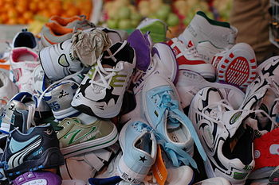
Borrowing my stuff
You are expected to have materials EVERY DAY.
Borrowing pencils/collateral
Recycled papers
Tissue, Germ-X

Slide 9
STEM
Science, Technology, Engineering, Mathematics
Technology is a necessity (Examples: sanitation workers and Wal-Mart clerks)
Projected STEM jobs by 2015: from 6.8 million to 8 million
STEM is best equal opportunity employer for minorities and women
STEM: 2 jobs/per person; Non-STEM: 2 jobs/6 people
Earning potential double than non-STEM majors (Less school for more money!!!)

Slide 10
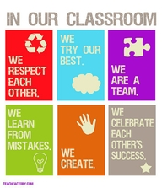
Contracting: Think-Pair-Share
Define contract.
Identify when you have felt comfortable sharing your ideas and questions in a class.
Identify when you have had ideas or quesitons but have not shared them. Why not? What was happening in that moement?

Slide 11
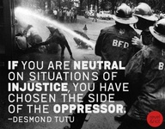
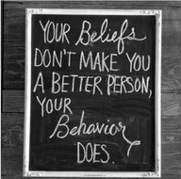
Why do they matter?
Practice!
Quiet the haters
Our purpose here
Checking

Slide 12
What are class norms?
Class norms are guidelines and expectations for how we treat each other while in Biology class.
We will come up with 5-6 statements that describe how we interact with one another, accountable talk, and our classroom culture.

Slide 13
Brainstorming
When we have an idea or question we would like to share, we can . . .
When we have an idea, but do not feel comfortable sharing it out loud, we can . .
When someone says something that we appreciate, we can . . .
When someone says something that might be confusing or offensive, we can
To make sure all students have the opportunity to participate in a class discussion, we can . . .
If we read or watch something that makes us feel sad or angry, we can . . .
To show respect for the ideas of others, we can . . .

Slide 14
Brainstorming norms
Let ideas flow freely. (Quantity not quality)
No evaluating ideas.
Build on other’s ideas.
There are no bad ideas!
No debating
Everyone participates!
Think in new ways.

Slide 15
Class norms brainstorm +Celebratory Signing!

Slide 16
Exit Ticket
1. How can we hold each other accountable to our class norms? Provide two ideas. (Examples: Should we receive rewards? Should a student monitor us? Are there ways to practice our class norms every day?)

Slide 17
Closure
Tomorrow: Henrietta Lacks + The Immortal Cell Line

