Slide 1
Catalyst #2: October 14th, 2014
What are the smaller, repeating units that make up a polymer called?
What three elements are found in all living things?
Define monomer.

Slide 2
Agenda
Catalyst: 5 minute
Macromolecule Structure, Function, and Examples Notes: Carbohydrates and Proteins (15 minutes)
Graphic Organizer, Part 1 (10 minutes)
Begin Macromolecule Review Worksheet (Remaining)
Homework:
DBA #6: Due 10/15
Flipped Video 2: Macromolecules, 10/20

Slide 3
Announcements
Office hours today
Macromolecule Quiz on Friday
Employees

Slide 4
Unit 3: Guiding Questions
What molecules are found in all living organisms?
Why do we need to eat a balanced diet that contains a variety of foods?

Slide 5
Objectives
SWBAT identify the chemical structure of each of the macromolecules.
SWBAT describe the main functions of each of the macromolecules.

Slide 6
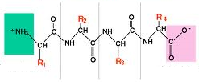
Proteins: Structure
Proteins are chains of amino acids that have a NH3 group, COOH group, and multiple R groups
What are proteins made up of?
Monomer: Amino Acids
Additional notes: Proteins are 3D structures—folded to match their function

Slide 7
Proteins: Function
Key Point: Proteins have multiple functions
Speed up chemical reactions (enzymes)
Provide structural support to cells
Build muscle, skin, and hair cells

Slide 8
Proteins: Examples
Key Point: Two common examples of proteins are enzymes and transport proteins
Enzymes speed up reactions
Transport proteins bring molecules into and out of cells

Slide 9
Proteins Examples: They really are the building blocks!
Just today….
Endorphins: Happiness!
Enzymes: Digesting food!
Antibodies: Preventing infectious disease

Slide 10
Carbohydrates: Structure
Carbohydrates are chains of monosaccharides, which are 6-carbon rings
Monomer: Monosaccharides

Slide 11
Monosaccharides
Glucose is the MOST COMMON monosaccharide! It is produced by plants through photosynthesis (basic molecule of energy)
Our bodies break down carbohydrates into glycogen
Two types of carbohydrates: Sugars and Starches
Plants produce starch (Potatoes, corn)

Slide 12
Carbohydrates: Function
Key Point: Carbohydrates have two key functions
Provide short-term energy to cells
Make up the cell wall of plant cells

Slide 13
Carbohydrates: Examples
Key Point: Examples of carbohydrates are glucose, sucrose, starch and cellulose
Glucose and sucrose are sugars
Glucose is what is measured to test for diabetes

Slide 14
Macromolecule Manipulatives + Graphic Organizer
Instructions:
We will be completing the Proteins and Carbohydrates columns today.
Cut out the appropriate squares and glue those on your graphic organizer.
Then, complete problems 1-10 on your Review worksheet.

Slide 15
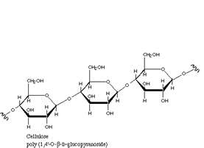
Exit Ticket
Which macromolecule is pictured to the right?
Which macromolecule provides short-term energy to cells?
Provide one example of a protein functioning in your body right now.

Slide 16
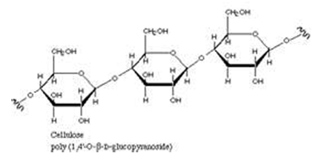
Catalyst #3: October 16th, 2014
What is one function of proteins?
2. Many runners eat foods such as breads, pasta, and potatoes an hour or two before their races. What macromolecules do these foods contain and how would they assist athletes?
3. Which macromolecule is pictured below?

Slide 17
Agenda
Catalyst: 5 minute
Macromolecule Structure, Function, and Examples Notes: Lipids and Nucleic Acids (15 minutes)
Graphic Organizer, Part 2 (10 minutes)
Macromolecule Review Worksheet, Part 2 (Remaining)
Homework:
DBA #6: Due 10/15
Flipped Video 2: Macromolecules, 10/20

Slide 18
Announcements
Macromolecule Quiz on Friday

Slide 19
Unit 3: Guiding Questions
What molecules are found in all living organisms?
Why do we need to eat a balanced diet that contains a variety of foods?

Slide 20
Objectives
SWBAT identify the chemical structure of each of the macromolecules.
SWBAT describe the main functions of each of the macromolecules.

Slide 21
Lipids: Structure
One common type of lipids (triglycerides) have a glycerol head group and three fatty acid tails
Monomer: 3 fatty acid tails and a glycerol
Triglycerides found in butter, white meat, and oils

Slide 22
Structure Continued
Grouped by non-polarity to water
Can be saturated or unsaturated
Unsaturated: double bonds, unable to pick up extra hydrogen molecules, not saturated
Saturated: Single bonds; pick up hydrogen molecules so saturated with hydrogen
Peanut Butter
Top, oily part: Unsaturated
Pasty part: Saturated (single bonds); can pack together tightly

Slide 23
Lipids: Function
Key Point: Lipids have two key functions
Store long-term energy
Make up the cell membrane of all cells

Slide 24
Lipids: Examples
Key Point: Examples of lipids are phospholipids, testosterone, estrogen, and cholesterol
Phospholipids make up the cell membrane
Testosterone and estrogen are sex hormones
Cholesterol can clog blood vessels and raise blood pressure

Slide 25
Nucleic Acids: Structure
Nucleic acids have a single or double strand of nucleotides
Monomer: Nucleotides

Slide 26
Nucleic Acids: Function
Key Point: The main function of nucleic acids is to store and transmit genetic information

Slide 27
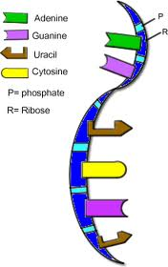
Nucleic Acids: Examples
Key Point: The two types of nucleic acids are DNA and RNA

Slide 28
Macromolecule Manipulatives + Graphic Organizer
Instructions:
We will be completing the Lipids and Nucleic Acids columns today.
Cut out the appropriate squares and glue those on your graphic organizer.
Then, complete all problems on your Review worksheet. (This will be due tomorrow.)

Slide 29
Exit Ticket
What is one function of lipids?
Which macromolecule stores genetic information?
3. What is one similarity between carbohydrates and lipids?
a.They both function in providing the body with energy.
B. They are both made of amino acids.
c. They are both nucleic acids.
D. They are useless to the body.

