Slide 1
Catalyst #3: January 12th, 2014
1. Photosynthesis begins with ___________ energy and ends with __________ energy (in the form of ___________).
2. What are the two reactants of photosynthesis?
3. What is the major product of photosynthesis?

Slide 2
Agenda
Catalyst (5 minutes)
6th and 7th relay (7 minutes)
Photosynthesis Foldable (15 minutes)
Photosynthesis Equation(20 minutes
Challenge Questions(Remaining)
Homework:
  DBA 13: 1/26

Slide 3
Announcements
Discovery letters due by Friday
Employee paychecks
Seating charts
Employees need training?
Check notes

Slide 4
Unit 5: Guiding Questions
How do plants make food for themselves?
Why do all organisms need some source of food?
Why do we and most other organisms need oxygen?

Slide 5
Today’s SPI & Objectives
SPI 3210.3.3 Compare and contrast photosynthesis and cellular respiration in terms of energy transformation.
SWBAT express the process of photosynthesis in the form of a chemical equation
SWBAT identify the reactants and products of photosynthesis and describe how the plant acquires each reactant

Slide 6


Photosynthesis
Biology
Unit 5

Slide 7
Review
Photosynthesis is the process plants use to produce food for themselves (Key Point 1)
During photosynthesis, plants covert solar energy into chemical energy (Key Point 2/3)
Photosynthesis occurs in the chloroplasts of plant cells (Key Point 4)
Chlorophyll is the chemical in chloroplasts that absorbs the sunlight needed (Key Point 5)
PHOTOSYNTHESIS

Slide 8
Chemical Reactions
Photosynthesis is a chemical reaction
In a chemical reaction, one set of substances (reactants) are converted into another set of substances (products)
What is on the left side of the arrow in a chemical equation?
What is on the right side of a chemical equation?
Reactants → Products

Slide 9
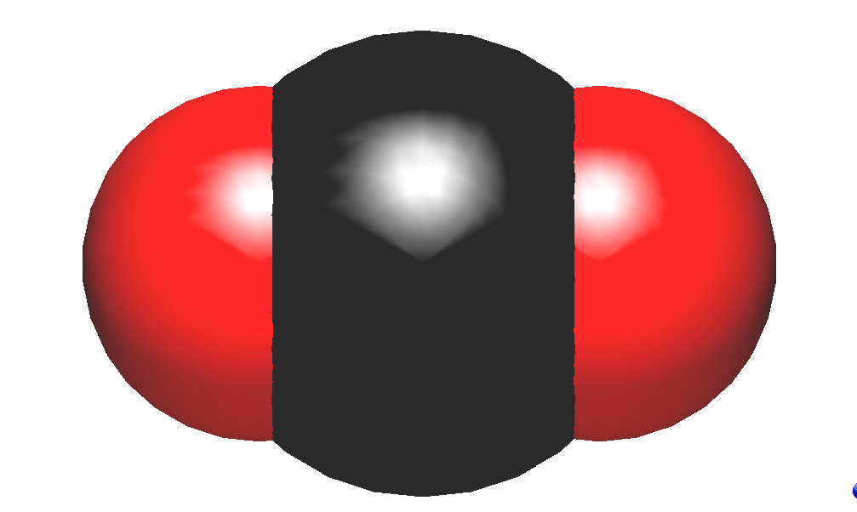
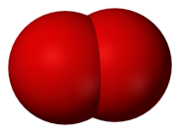
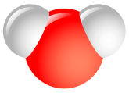
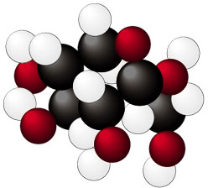
Photosynthesis Equation
6 CO₂ + 6 H₂O → C₆H₁₂O₆ + 6 O₂
REACTANTS
PRODUCTS
Notes:
9
Oh, NOW it works. Have them write down the balanced equation. Photosynthesis: 6CO2 + 6H2O + sunlight --> C6H12O6 + 6O2
Why do we need the sunlight? Well, that is what provides the energy to move everything around, and break/create all those chemical bonds.
You should spend the bulk of your time on this slide.

Slide 10
Reactants
What is one reactant needed for photosynthesis?
  Carbon dioxide (CO2)
How does a plant acquire this reactant?
  Plants take in CO2 from the air through their leaves

Slide 11
Reactants
What is the other reactant needed for photosynthesis?
  Water (H2O)
How does a plant acquire this reactant?
  Plants take in water from the ground through their roots

Slide 12

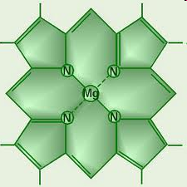
Catalyst
Remember, a catalyst is something that speeds up a reaction but is not used up (not a reactant)
What is the catalyst in photosynthesis?
  Sunlight is the catalyst
How do plants acquire this catalyst?
  Plants capture sunlight using chlorophyll

Slide 13
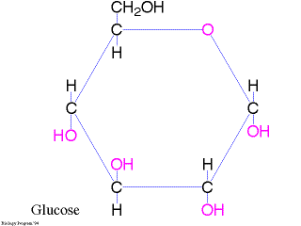
Products
What is one product of photosynthesis?
  Glucose (C6H12O6)
What does the plant do with this product?
  Plants use glucose to produce energy for their cells

Slide 14
Products
What is the other product of photosynthesis?
  Oxygen (O2)
What does the plant do with this product?
  Plants release oxygen back into the atmosphere for organisms to breathe

Slide 15
CFU 1
What are the reactants of photosynthesis?
  Carbon dioxide and oxygen
  Water and carbon dioxide
  Glucose and water
  Water and oxygen
  Answer: B water and carbon dioxide

Slide 16
CFU 2
What is one thing plants need for photosynthesis but is not a reactant that is used up?
Answer: Sunlight

Slide 17
CFU 3
What is produced during photosynthesis that plants use to produce energy for their cells?
Answer: Glucose

Slide 18
CFU 4
Where do plants get each reactant from?
  H2O from the ground using their leaves and CO2 from the air using their roots
  H2O and CO2 from the ground using their roots
  CO2 from the air through their leaves and H2O from the ground through their roots
  H2O and CO2 from the air using their leaves
Answer: C

Slide 19


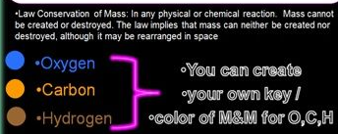
Label each arrow with either a reactant or product.

Slide 20
Photosynthesis Equation Steps
1. Create a color code for the molecules.
Example: Oxygen=blue; carbon = orange; hydrogen = red
2. Arrange your molecules into your two reactants.
3. Label the reactants on the leaf.
4. Rearrange the reactants into the two products.
5. Label the products on the leaf.
6. Check equation with Ms. M

Slide 21
Challenge Questions
Answer the following questions on the back of your mini-poster when you finish:
Some scientists believe that too much carbon dioxide in the atmosphere causes global warming—a gradual increase in the temperature of the earth. What effect do plants have on the amount of CO2 in the atmosphere?
What would happen to the amount of CO2 in the air if many forests were cleared (trees were cut down)?
What effect do plants have on the amount of oxygen in the atmosphere?
What would happen to the amount of O2 in the air if more trees were planted around the world?

Slide 22
Exit Ticket
Answer the questions below without using your notes
What are the two reactants needed for photosynthesis to occur?
Where does the plant get each reactant from?
What are the two products of photosynthesis?

