Slide 1
Catalyst #4: January 13th, 2015
1. Which of the following is the correct balanced equation for photosynthesis?
a. 6 O₂ + C₆H₁₂O₆ → 6 CO₂ + 6 H₂O
b. 6 CO₂ + C₆H₁₂O₆ → 6 O₂ + 6 H₂O
c. CO₂ + H₂O → 6 C₆H₁₂O₆ + O₂
d. 6 CO₂ + 6 H₂O → C₆H₁₂O₆ + 6 O₂
2. Which equation best summarizes the process of photosynthesis?
a. water + carbon dioxide → sugars + oxygen
b. sugars + oxygen → water + carbon
c. oxygen + carbon dioxide → sugars + oxygen
d. water + carbon dioxide → oxygen + carbon
3. If the number of plants in the ecosystem decreased significantly, how would the levels of carbon dioxide and oxygen most likely be affected?
A. Carbon dioxide would increase and oxygen would decrease.
B. Carbon dioxide would decrease and oxygen would increase.
C. Carbon dioxide and oxygen would both decrease.
D. Carbon dioxide and oxygen would both increase.

Slide 2
Agenda
Catalyst (5 minutes)
Cosmos clip (5 minutes)
Phases of Photosynthesis Reading (11 minutes)
Phases of Photosynthesis PPT (11 minutes)
SWAT! (Remaining)
Homework:
Study for a quiz on photosynthesis!
DBA 13: 1/26

Slide 3
Announcements
Discovery letters due on Friday
Mid-Year ACT on Friday

Slide 4
Unit 5: Guiding Questions
How do plants make food for themselves?
Why do all organisms need some source of food?
Why do we and most other organisms need oxygen?

Slide 5
Today’s SPI & Objectives
SPI 3210.3.3 Compare and contrast photosynthesis and cellular respiration in terms of energy transformation.
SWBAT distinguish between the light-dependent and light-independent reactions of photosynthesis in terms of reactants, products, and location

Slide 6
Phases of Photosynthesis
PHOTOSYNTHESIS
Biology

Slide 7
Review
The equation for photosynthesis is:
6 CO₂ + 6 H₂O → C₆H₁₂O₆ + 6 O₂
The reactants are : carbon dioxide and water
CO2 enters through the leaves
H2O enters through the roots
The products are: glucose and oxygen
Glucose is used for chemical energy and oxygen is released into the air

Slide 8
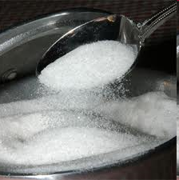
Phases of Photosynthesis
Key Point 1: Photosynthesis occurs in two phases—light-dependent and light-independent (Calvin cycle)

Slide 9
Light-Dependent Phase
Opening Question 1: What is the first phase known as?
The light-dependent phase
Opening Question 2: What is required for the first phase to begin?
Sunlight
Opening Question 3: In what part of the chloroplast does the first phase occur?
Thylakoids (look like discs stacked)

Slide 10
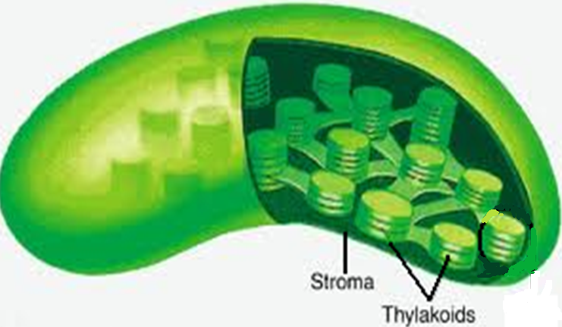
Location of Light-Dependent Phase

Slide 11
Light-Dependent Phase
Key Point 2: The light-dependent phase, which occurs in the thylakoids of the chloroplasts, happens first and requires sunlight to begin
Light-dependent=needs light

Slide 12
Light-Dependent Phase
Question 4: What reactant is split by the sunlight during this phase?
Water (H2O)
Question 5: What gas is produced and released during this first phase of photosynthesis?
Oxygen (O2)
Question 6: What two energy-storage molecules are formed during the first phase of photosynthesis?
NADPH and ATP

Slide 13
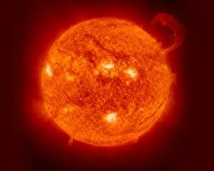
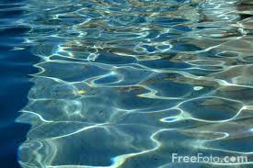
Light-Dependent Phase
Key Point 3: During the light-dependent phase, water (H₂O) is split by the sunlight, and oxygen is produced along with the energy-storage molecules NADPH and ATP
Splitting H2O releases hydrogen (H), oxygen (O), and electrons
Electrons help produce NADPH
Hydrogens (H+) move through ATP synthase enzymes to produce ATP

Slide 14
Light-Independent Phase
Question 7: In what part of the chloroplasts does the light-independent phase occur?
The stroma
Question 8: What is another name for the light-independent phase of photosynthesis?
The Calvin cycle

Slide 15
Light-Independent Phase

Slide 16
Light-Independent (Calvin cycle)
Key Point 4: The Calvin cycle, which happens second, occurs in the stroma of the chloroplasts and does not require sunlight

Slide 17
Calvin Cycle
Question 9: What reactant is taken in through the leaves and used in the second phase of photosynthesis?
Carbon dioxide (CO2)
Question 10: What is produced during the light-independent phase of photosynthesis?
Glucose

Slide 18
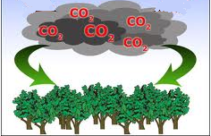
Calvin cycle
Key Point 5: During the Calvin cycle, carbon dioxide (CO₂) and the energy stored in NADPH and ATP are used to help produce glucose for the plant cell
CO2 enters through the leaves and combines with other carbon-containing molecules
Energy in NADPH and ATP is transferred to these molecules
The molecules move out of the cell and form glucose

Slide 19
SWAT!
Hydrogen ions
Chemical energy
Light-dependent
ATP synthases
NADPH
Organic molecules
Calvin cycle
Stroma
ATP
Sunlight
Light-independent
Glucose
Thylakoids
Electrons

Slide 20
Exit Ticket
Answer the questions below without using your notes.
What phase of photosynthesis happens first?
What is needed for the first phase of photosynthesis?
In what part of the chloroplast does the Calvin cycle happen? (thylakoids or stroma?)

