Slide 1
Catalyst: November 21st , 2014: On your post-it
What are you most confident about Monday’s test?
Prokaryotes/Eukaryotes B. Organelles C. Plant/Animal cells D. Microscopes
2. What are you LEAST confident about Monday’s test?
Prokaryotes/Eukaryotes B. Organelles C. Plant/Animal cells D. Microscopes
3. How are you going to study for this exam?

Slide 2
Agenda
Catalyst (6 minutes)
Unit 4 Practice Exam (20 minutes)
Unit 4 Jeopardy (Remaining)
**Honors: data recordings
Homework:
STUDY FOR UNIT 4: CELLS TEST (Monday)
Honors Projects: LESS THAN TWO WEEKS
DBA #11: 11/27

Slide 3
Announcements
TEST MONDAY

Slide 4
Unit 4: Guiding Questions
What are all living organisms made up of?
What does each part of the cell do?
What different types of cells exist and how are they different?
What tools are used to study the cell?

Slide 5
Today’s Objectives
Review of all Unit 4: Cells objectives
Unit 4 practice exam
Past test question
You may work with partner or by yourself
Star questions you would like to review!
Try to NOT use your notes AS MUCH AS POSSIBLE. Treat this like an exam!

Slide 6
Grugeball Review
Notes and study guides CANNOT be used
DO NOT SHOUT OUT ANSWERS
Rules/Shots/Steals

Slide 7
Review Notes
Take out a sheet of notebook paper
After each question, write the answers underlined in yellow on a sheet of notebook paper
Use these notes to study over the weekend!
Also use any other notes and your Unit 2 Study Guide

Slide 8
Basics of the Cell
Prokaryotic vs.
Eukaryotic
Parts of the Cell
Plant vs. Animal
Cells
100 pt
100 pt
100 pt
100 pt
200 pt
200 pt
200 pt
200 pt
300 pt
300 pt
300 pt
300 pt
400 pt
400 pt
400 pt
400 pt
500 pt
500 pt
500 pt
500 pt

Slide 9
Question: What is the basic unit of life?

Slide 10
Answer: The cell is the basic unit of life

Slide 11
Question: What piece of equipment is used to view the most basic features of the cell (cell membrane, cytoplasm, etc.)?

Slide 12
Answer: The light microscope is used to view the most basic features of cells

Slide 13
Question: What three features are found in all cells?

Slide 14
Answer: All cells contain a cell membrane, cytoplasm, and genetic material

Slide 15
Question: What piece of equipment is used to view the details of cells, such as mitochondria and the ER?

Slide 16
Answer: The electron microscope is used to view the details of cells, such as specific organelles

Slide 17
Question: What key feature does a eukaryotic cell have that a prokaryotic cell does not?

Slide 18
Answer: Prokaryotic cells do not have a nucleus

Slide 19
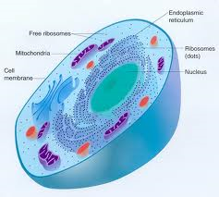
Question: What type of cell is pictured below– prokaryotic or eukaryotic?

Slide 20
Answer: Eukaryotic cell (it has a nucleus and membrane-bound organelles)

Slide 21
Question: You discover a cell with membrane-bound organelles like the ER and mitochondria. What type of cell is it?

Slide 22
Answer: Eukaryotic cells have nuclei and membrane-bound organelles.

Slide 23
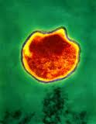
Question: Is the organism below (Chlamdyia bacterium) a prokaryote or eukaryote?

Slide 24
Answer: Prokaryotes are always unicellular

Slide 25
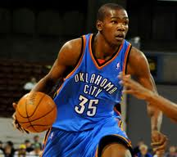
Answer: All multi-cellular organisms (such as those pictured below) are made up of what type of cells?

Slide 26
Answer: All multi-cellular organisms are made up of eukaryotic cells

Slide 27
Question: You discover a unicellular organism that has its genetic material in the cytoplasm, not a nucleus. Is it a prokaryote or eukaryote?

Slide 28
Answer: Prokaryotes are always unicellular (one cell)

Slide 29
Question: What is the function of the cell membrane?

Slide 30
Answer: The cell membrane controls what enters and leaves the cell

Slide 31
Question: Where are proteins synthesized in the cell?

Slide 32
Answer: Proteins are synthesized in the ribosomes

Slide 33
Question: What is the function of the mitochondria?

Slide 34
Answer: Mitochondria produce energy in the form of ATP for the cell

Slide 35
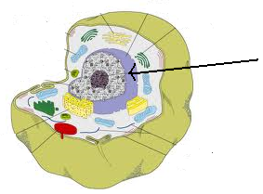
Question: What two things do the part labeled in the picture do?

Slide 36
Answer: The nucleus stores genetic material and controls the cell’s activities

Slide 37
Question: What three parts of the cell are involved in making proteins, moving them throughout the cell, and shipping them out of the cell?

Slide 38
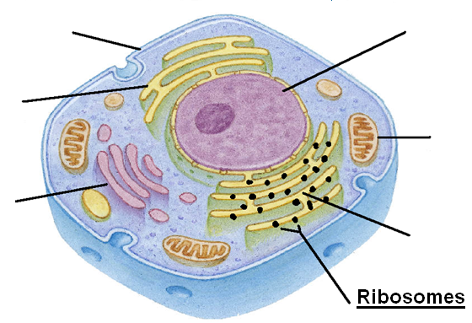
Answer: Ribosomes make the proteins, the rough ER transports the proteins, and the Golgi apparatus packages them and ships them out of the cell

Slide 39
Question: What is the function of the cell wall?

Slide 40
Answer: The cell wall gives extra protection and support to the plant cell

Slide 41
Question: What three structures are found in the plant cell but not in the animal cell?

Slide 42
Answer: The cell wall, chloroplasts, and central vacuole are only in the plant cell

Slide 43
Question: What is the function of the central vacuole in the plant cell?

Slide 44
Answer: The central vacuole stores extra water and nutrients for the plant cell

Slide 45
Question: What is one structure only found in the animal cell?

Slide 46
Answer: Centrioles are only found in the animal cell

Slide 47
Question: Why are chloroplasts only found in the plant cell?

Slide 48
Answer: Chloroplasts make food for the plant cell, and animals do not need to make food in their cells

